Slide 1
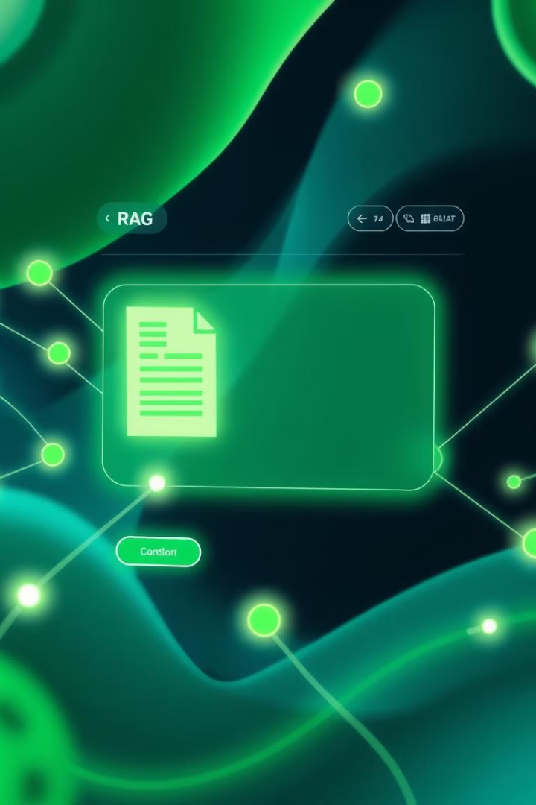


RAG Application Overview
A Retrieval Augmented Generation (RAG) application that allows users to upload documents, ask questions about them, and receive contextually relevant answers using advanced AI technologies.
by Kumar Naga Sai Siva Shankar Ganireddi

Slide 2


Introduction to RAG
Retrieval
Augmented
Generation
Find relevant documents.
Enhance question with context.
Produce relevant answers.

Slide 3
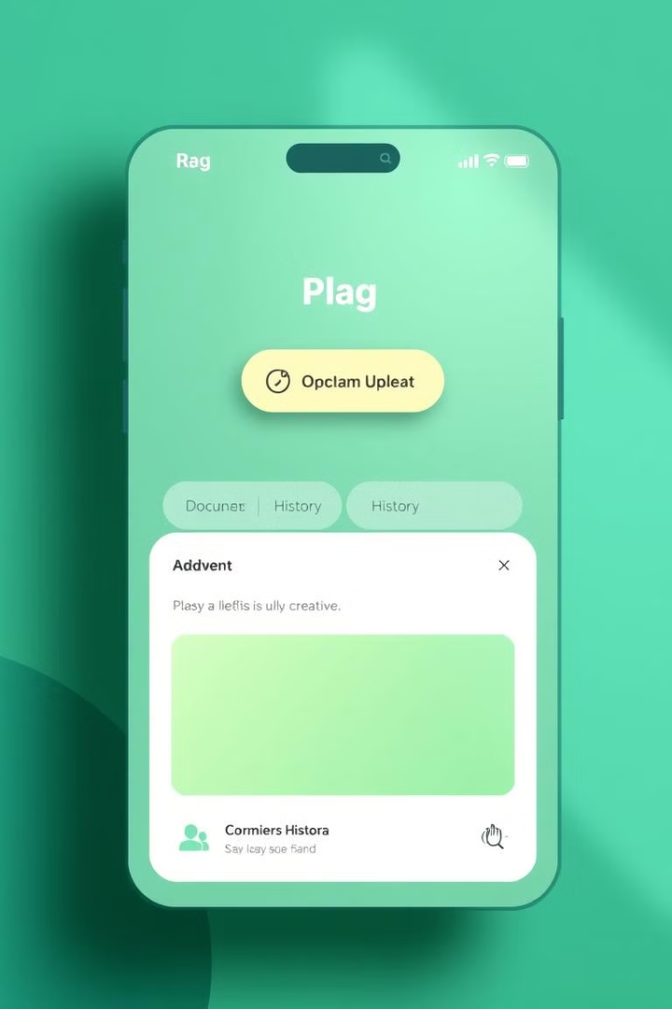
Features of RAG Application
Document Upload
Semantic Search
Question Answering
Supports PDF and DOCX files.
Efficient vector storage.
Llama 3 via Together.ai.
Conversation History
MySQL database management.

Slide 4

Supported File Types & Processing
PDF
DOCX
Chunking
Parsed using PyPDF.
Parsed using python-docx.
RecursiveCharacterTextSplitter.

Slide 5
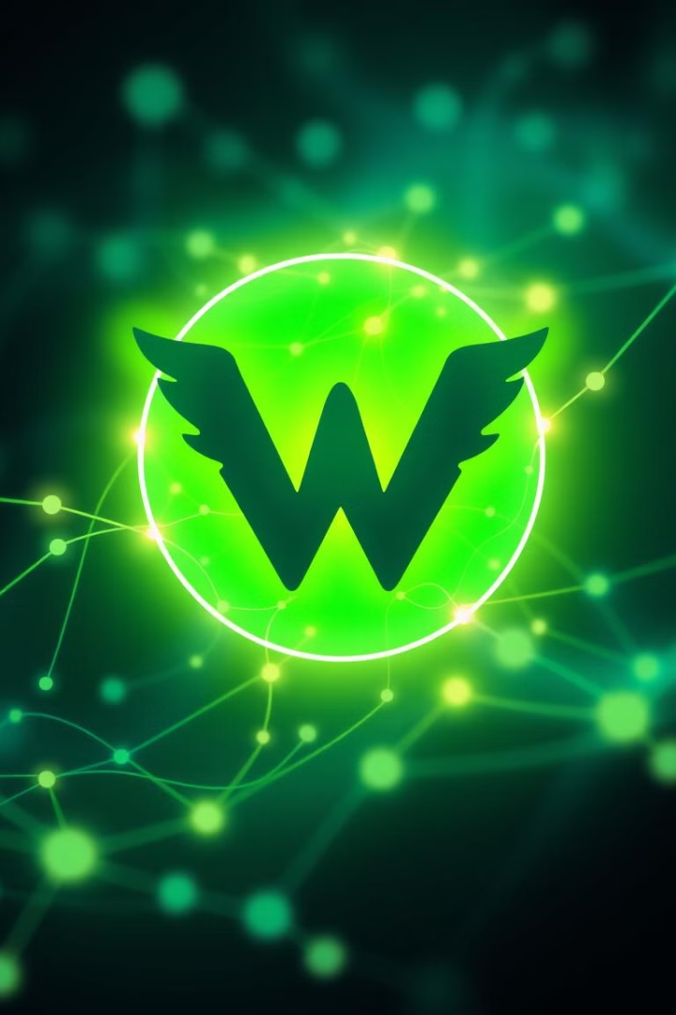

Vector Storage with Weaviate
1
Cloud-Native
2
Text2Vec
Built for cloud environments.
Native text embeddings.
3
LangChain
Seamless integration.

Slide 6





Question Answering Mechanism
Embeddings
Together.ai embeddings.
Semantic Search
Find relevant chunks.
Llama Model
Answer generation.

Slide 7
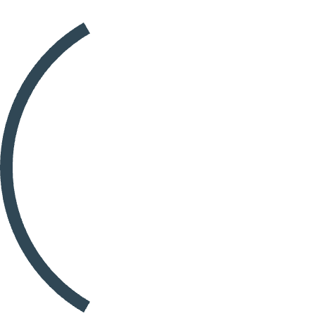



Conversation History Management
2
Document Metadata
Stores document metadata.
MySQL
1
Stores Q&A history.
Chunk Storage
Stores document chunks.
3

Slide 8

Frontend Overview
React
1
Modern web interface.
Material-UI
2
Components and theming.
Nginx
3
Static file serving.

Slide 9



Backend Overview
1
Flask API
2
LLM Service
3
Vector DB

Slide 10


Technical Architecture Overview
Backend Services
Frontend Services
API Server (Flask)
Web Application (React)
Vector Database (Weaviate)
Static File Server (Nginx)
Relational Database (MySQL)
API Gateway (Nginx)
LLM Service (Together.ai)

Slide 11





Data Flow in the Application
Document Upload
User uploads PDF/DOCX
Processing
Text splitting and embedding
Storage
Vectors to Weaviate, metadata to MySQL
Query
Semantic search finds relevant chunks
Response
LLM generates answer from context

Slide 12




Flowchart Representation of RAG Application
Frontend
User Interface, Document Upload, Question Input
Backend
Flask API, Document Processor, Text Splitter
Storage
3
Weaviate Vector DB, MySQL Relational DB

Slide 13
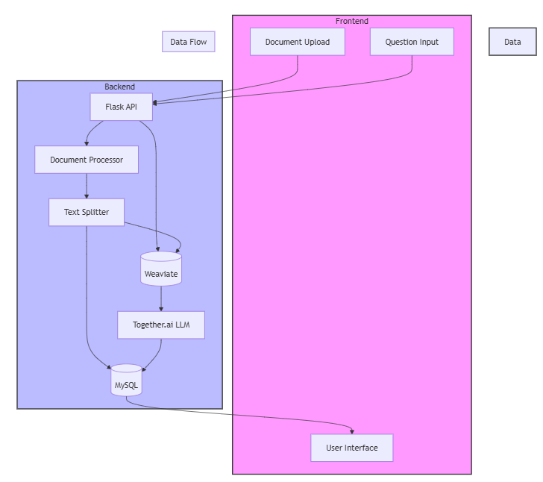
Flowchart Representation of RAG Application

Slide 14

Vector Database Selection: Why Weaviate?
Cloud-Native Architecture
Built for modern cloud environments
Built-in Text2Vec
Native support for text embeddings
LangChain Integration
Seamless integration with framework
Free Tier Available
For development and testing

Slide 15
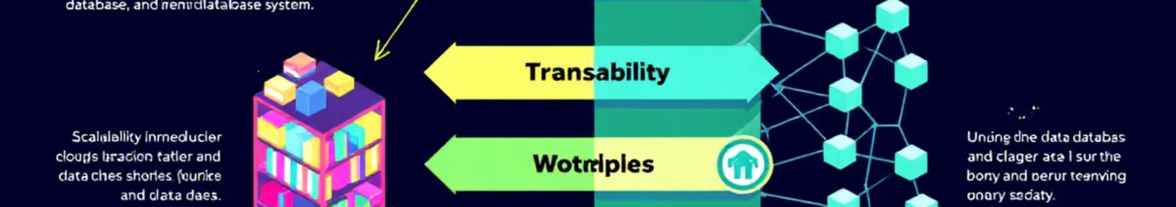

Comparison: Weaviate vs Pinecone
Feature
Weaviate
Pinecone
Cost
Lower pricing
Higher for production
Free Tier
More generous
More restricted
Setup
Simpler
More complex
Metadata
Flexible handling
Limited handling
API
Simpler for basics
More complex

Slide 16
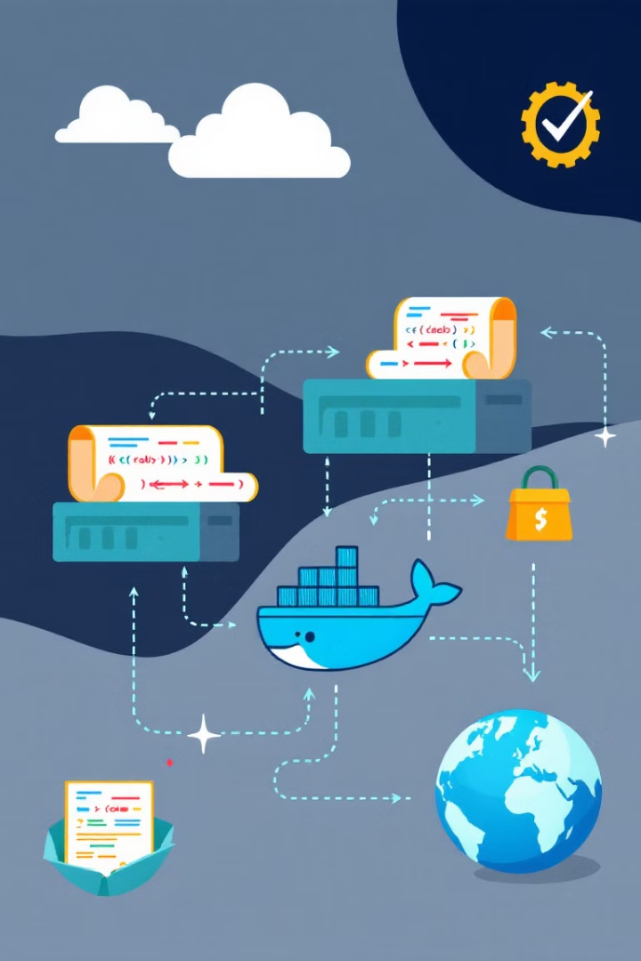




Deployment Setup: Docker & Environment Variables
Clone Repository
git clone https://github.com/yourusername/rag-app.git
Configure Environment
cp .env.example .env and edit variables
Build & Start
docker-compose up --build
Access Application
Frontend: localhost:3000, Backend: localhost:5000

Slide 17
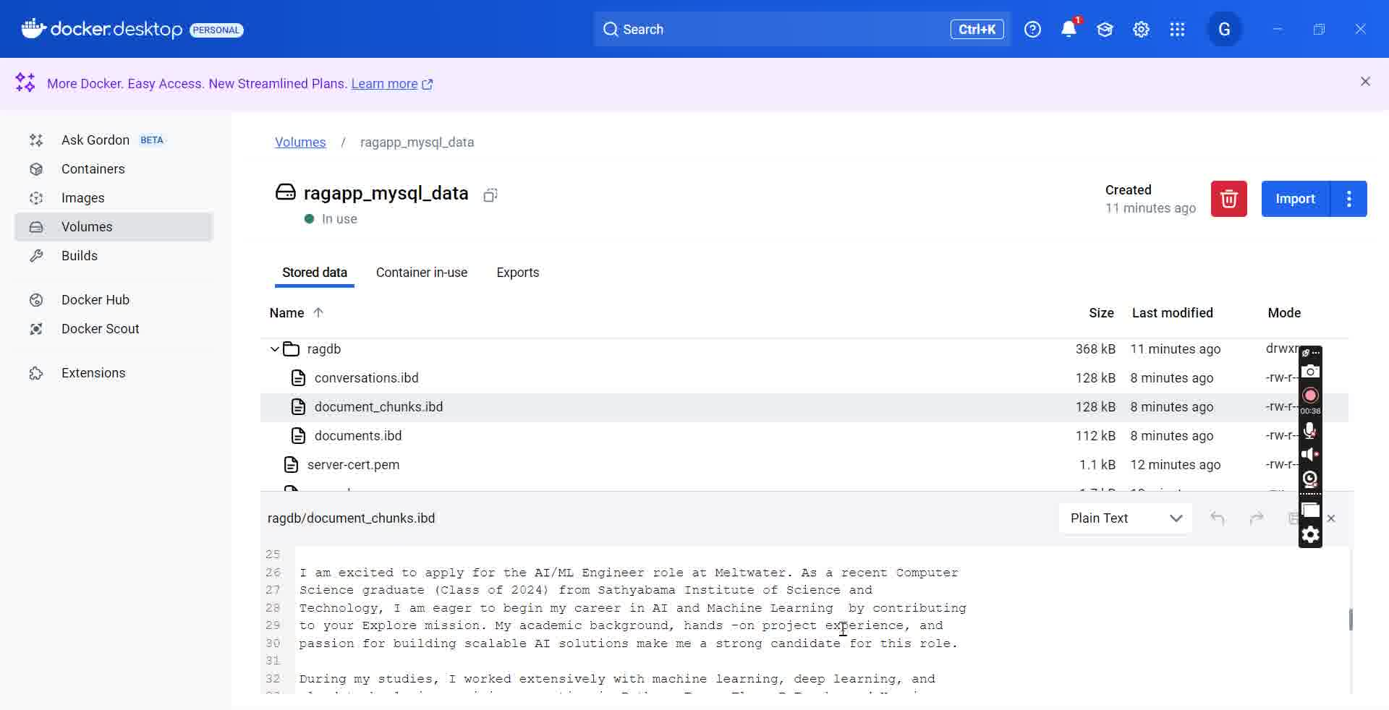
Deployment Setup Overview

Slide 18




Backend Technologies Used
Flask
RESTful API development
LangChain
RAG implementation
Weaviate
Vector storage and search

Slide 19
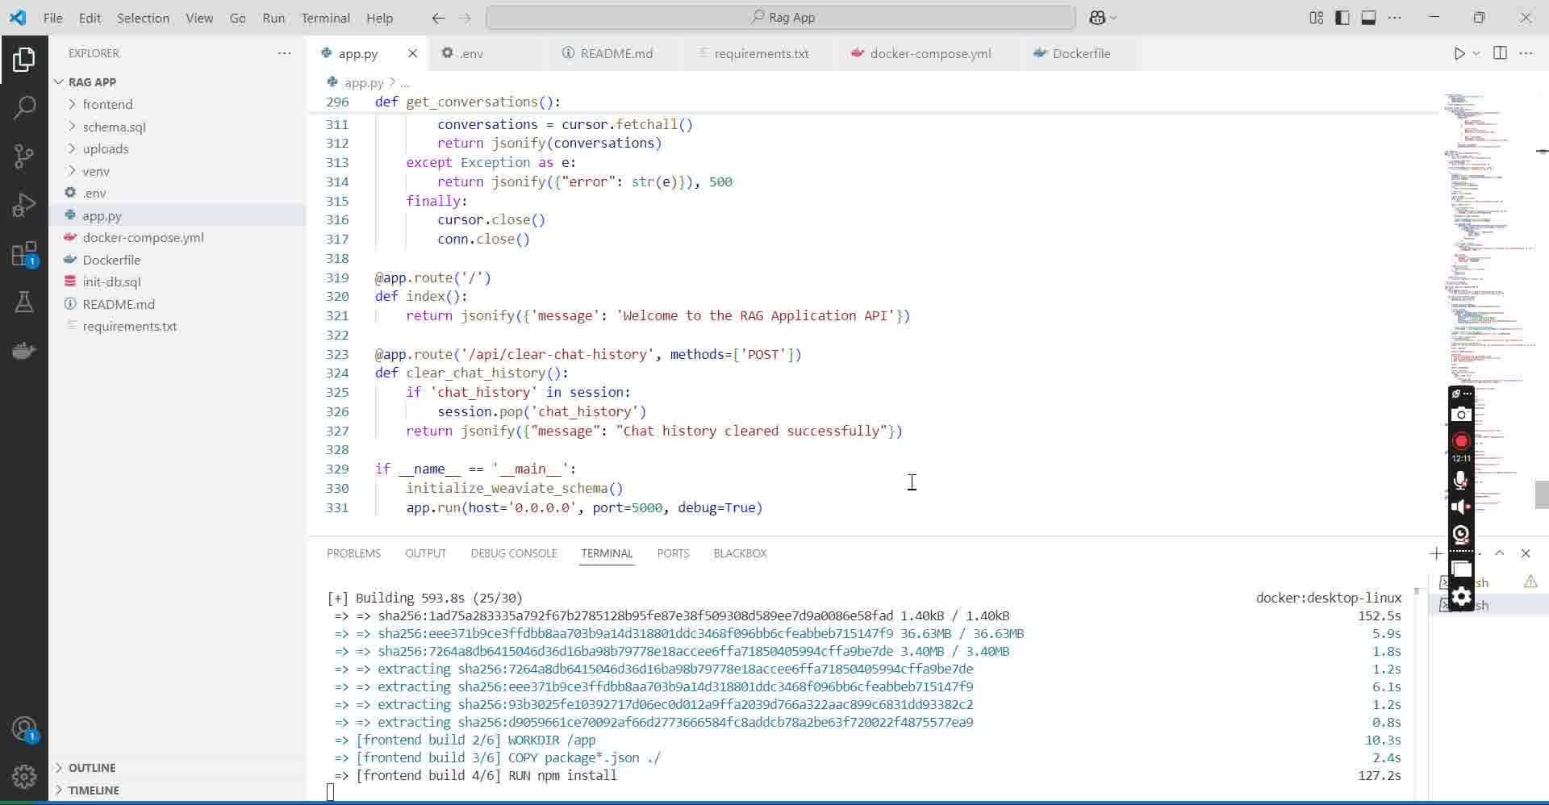
Backend Implementation Overview

Slide 20
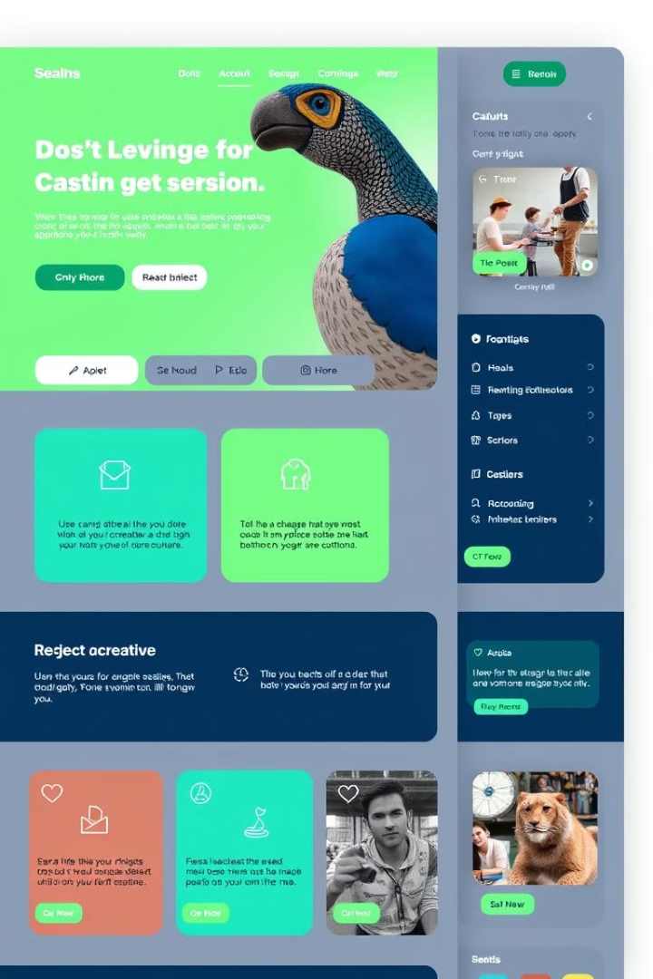



Frontend Technologies Used
React
UI components
React Router
Navigation
Nginx
Static files

Slide 21
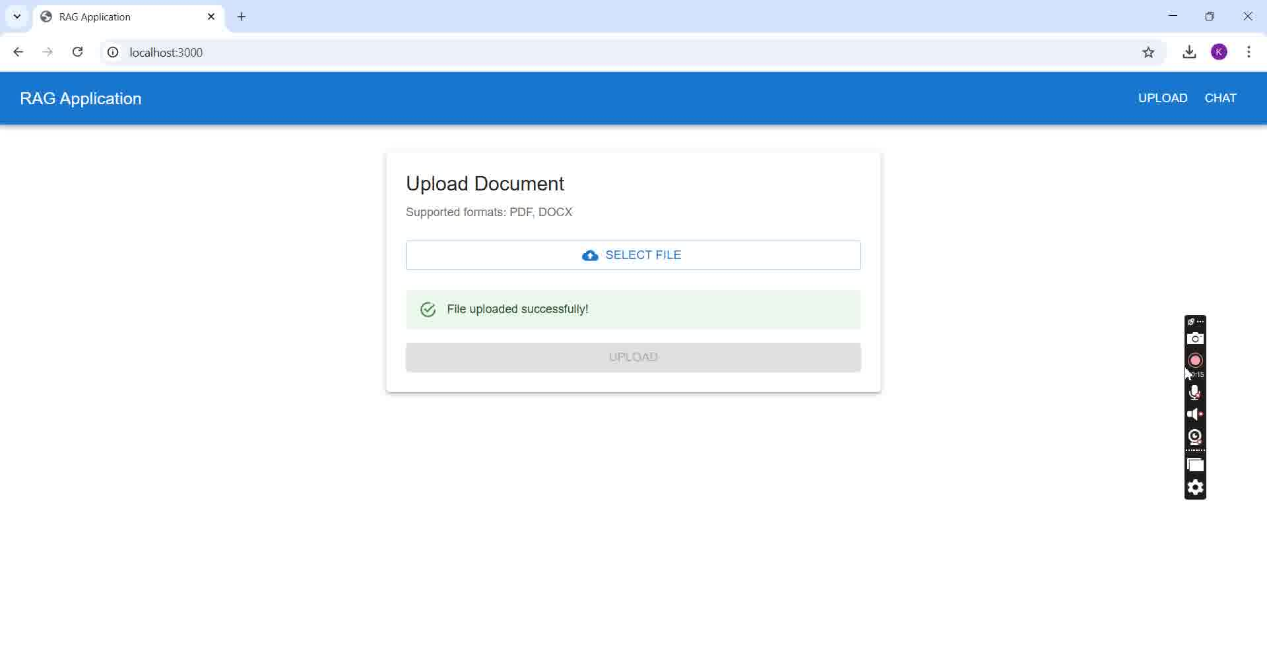
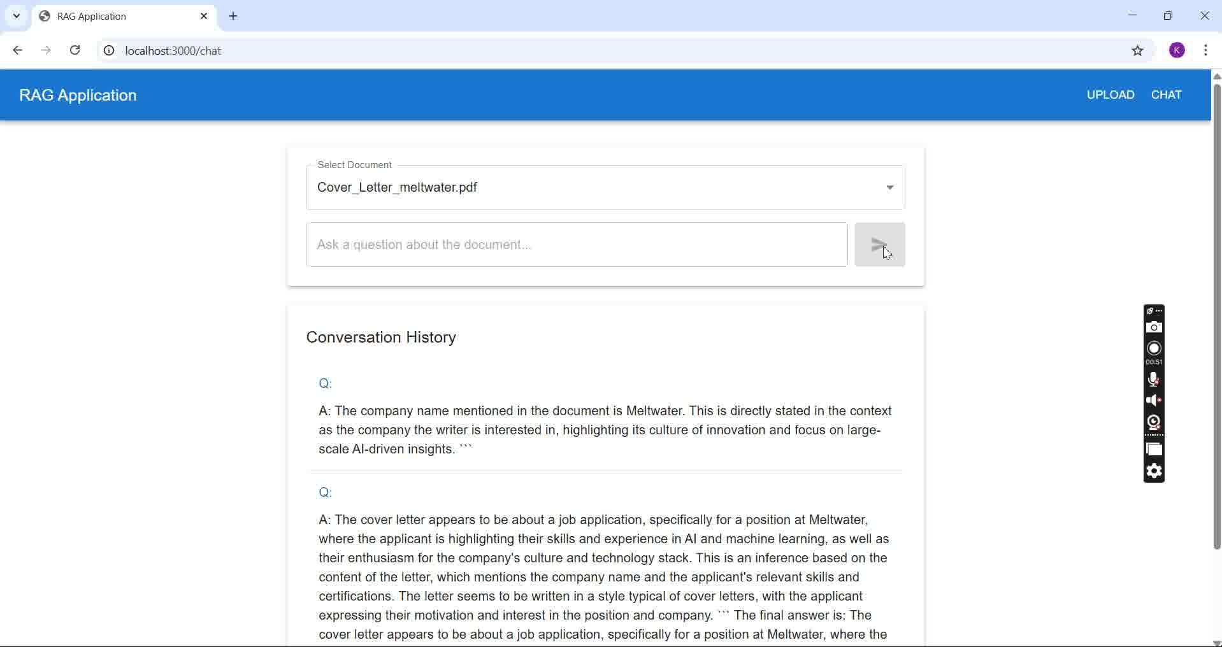
Frontend Overview

Slide 22
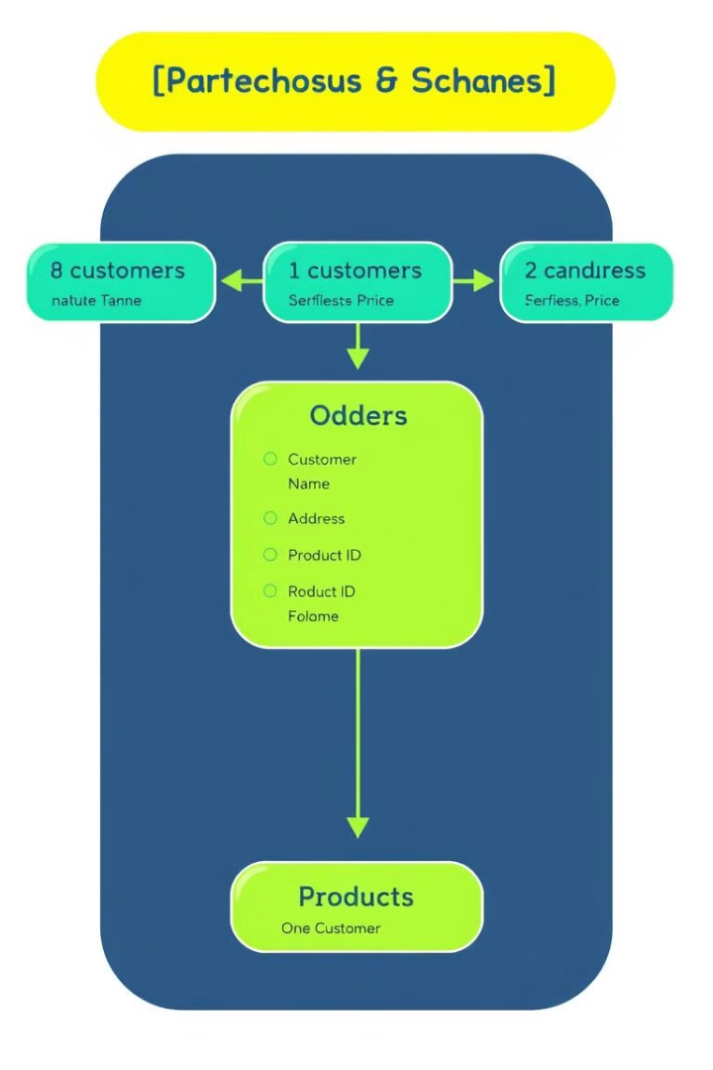
Database Schema Explanation
Documents
Document Chunks
Uploaded document metadata
Processed document chunks
Conversations
Q&A history

Slide 23
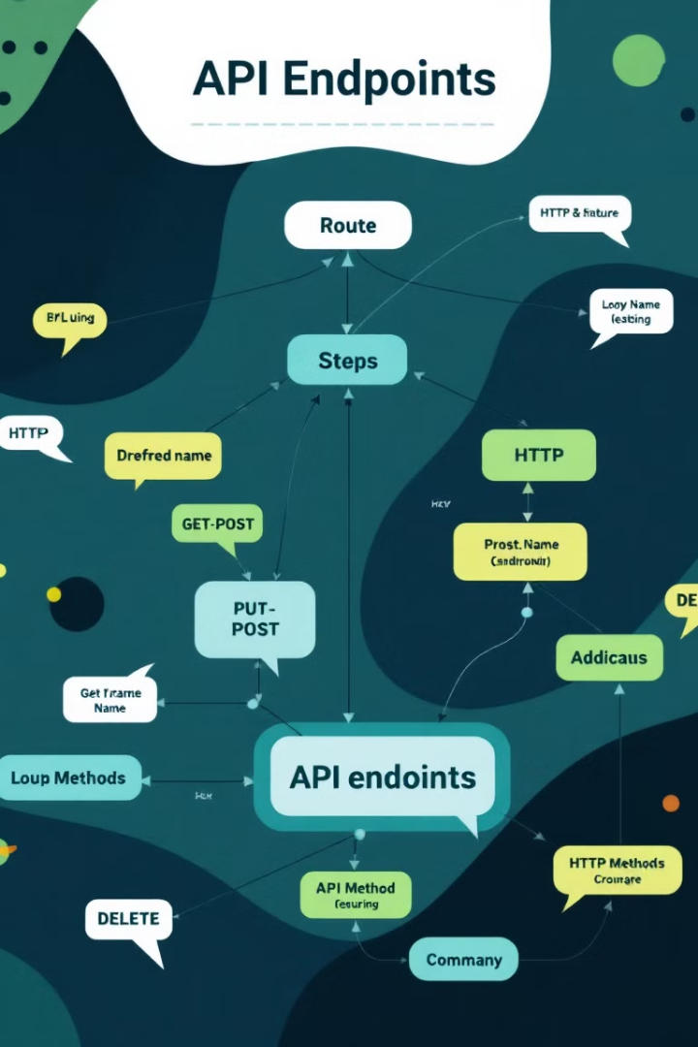
API Endpoints & Their Functions
POST /api/upload
POST /api/chat
GET /api/conversations
Upload and process documents
Send questions, get AI answers
Retrieve conversation history
GET /api/documents
List uploaded documents

Slide 24


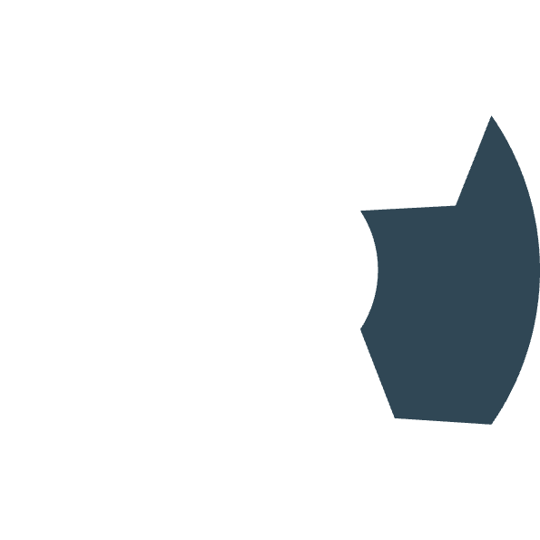








How the RAG Application Works
Text Chunking
Document Upload
Document split into manageable pieces
User uploads PDF/DOCX file
Vector Embedding
Chunks converted to vector representations
LLM Generation
Semantic Search
AI creates answer from context
Question finds relevant document chunks

Slide 25

Challenges !
Session Management:
The application currently does not create separate sessions for each user. This can lead
to issues with maintaining distinct chat histories, causing potential cross-user data
contamination and loss of personalized context.
Contextual Response Accuracy:
The fallback response "I don't have enough information" is returned for follow-up
questions when the retrieved context is insufficient. This indicates a challenge in
ensuring the context extraction and retrieval mechanism consistently provides
comprehensive and relevant data to generate accurate answers.

Slide 26

Path to Resolution
Enhanced Session Management:
Implement unique session identifiers for each user.
Use server-side session storage (e.g., Redis) to maintain isolated, persistent sessions.
Leverage secure cookies and Flask’s configuration to ensure proper session handling.
Improved Contextual Response:
Refine text chunking and context retrieval to capture more comprehensive document
data.
Adjust similarity thresholds and retrieval limits to reduce reliance on generic fallback
responses.
Enhance prompt engineering for better interpretation of follow-up queries.
Iterative Optimization:
Continuously monitor user feedback and session data for further refinements.
Test and fine-tune both session handling and context extraction mechanisms for
optimal performance.

Slide 27


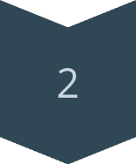
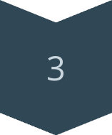
Future Improvements & Scalability
Enhance Document Support
Add more file types
Improve LLM Integration
Explore other models
Optimize Vector Search
Improve search speed

Slide 28

Conclusion & Final Thoughts
Scalability
Efficiency
The system supports growing data without major architectural changes.
Quick information retrieval, saves time and resources for users.
Adaptability
Easily modified to fit new data types and user requirements.

